Slide 1




Consumer Goods Analytics
SQL Project

Slide 2
AGENDA
Background/Context
Getting familiar with Atliq’s Business – Their Markets and Product lines
Getting familiar with the input data
Ad-hoc requests along with the queried results, visualizations and Insights

Slide 3

Background/Context
Our Company
Atliq Hardware, an imaginary company, stands out as a premier producer of computer hardware in India.
Background
The leadership observed a lack of sufficient insights for making prompt and intelligent decisions based on data.
Problem
The company requires insights for 10 ad-hoc requests.
Approach
Execute a SQL query to address these inquiries. Transform the results into visual representations and deliver the insights to the upper-level management.

Slide 4
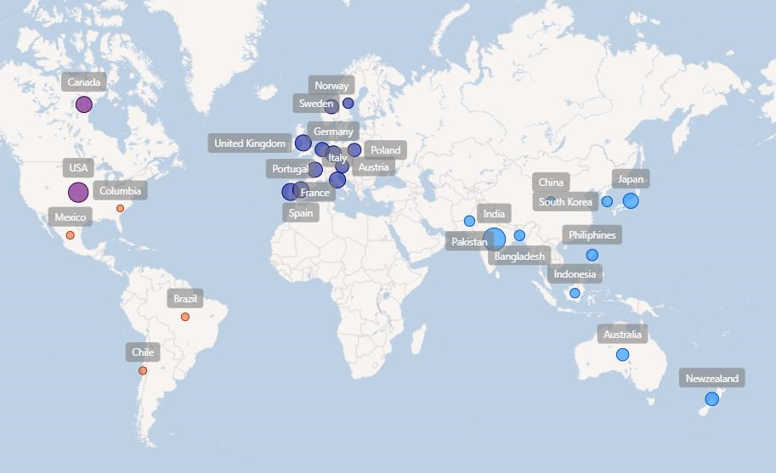
Getting familiar with Atliq’s Business –Their Markets and Product lines
Atliq’s Markets

Slide 5

Atliq’s Product lines
PC
Notebook
Gaming laptop
Business laptop
Personal laptop
Desktop
Business laptop
Personal laptop
P&A
Peripherals
Graphic card
Internal HDD
MotherBoard
Processors
Accessories
Batteries
Keyboard
Mouse
N&S
Networking
Wifi Extender
Storage
External SSD
USB Flash drives

Slide 6
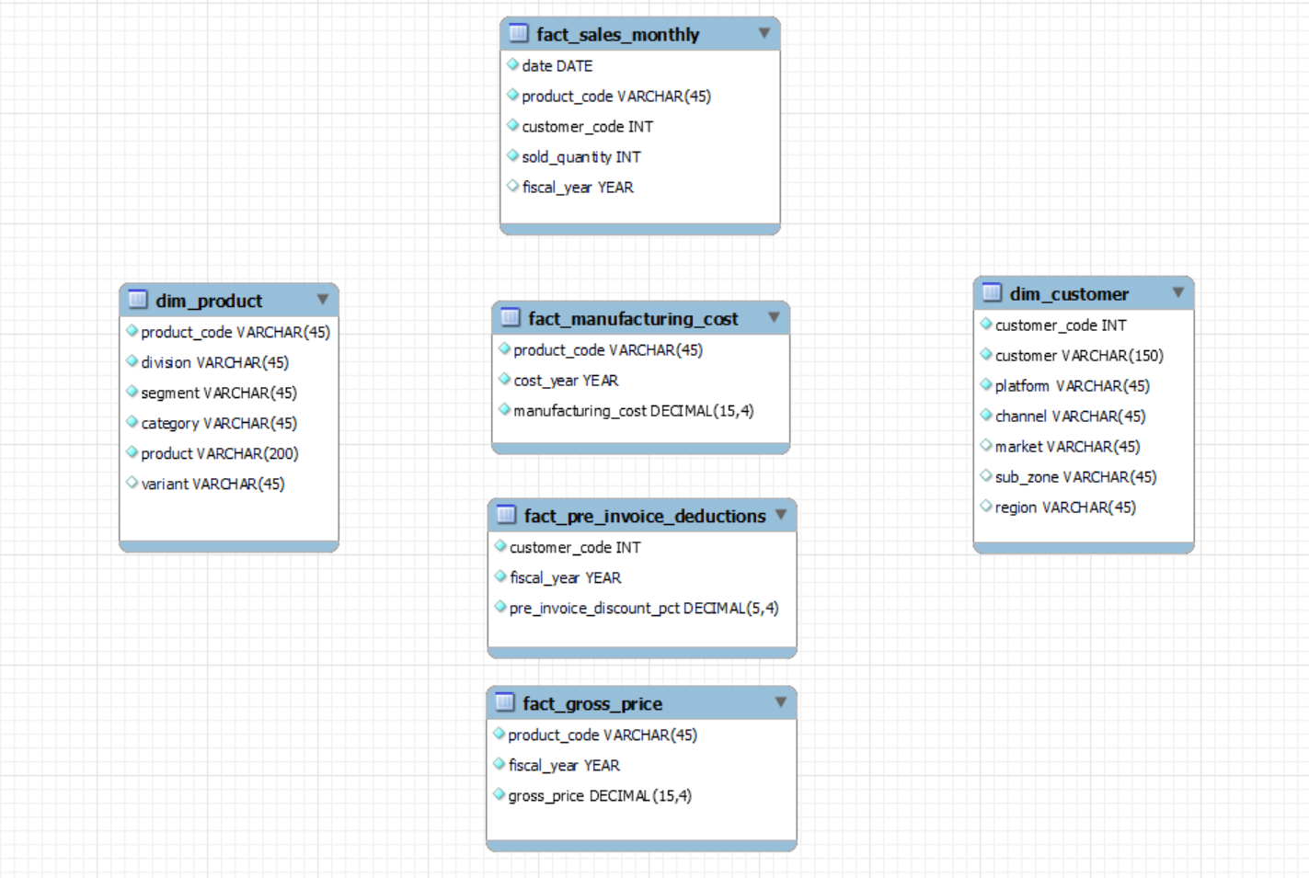
Getting familiar with the input data
The input data comprises sales data for both fiscal years 2020 and 2021, accompanied by various dimension tables such as customer details, product details, and others.

Slide 7

Ad -hoc requests, queried results, Insights and visualization

Slide 8
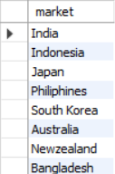
Ad -hoc requests
Provide the list of markets in which customer "Atliq Exclusive" operates its business in the APAC region.
Output

Slide 9
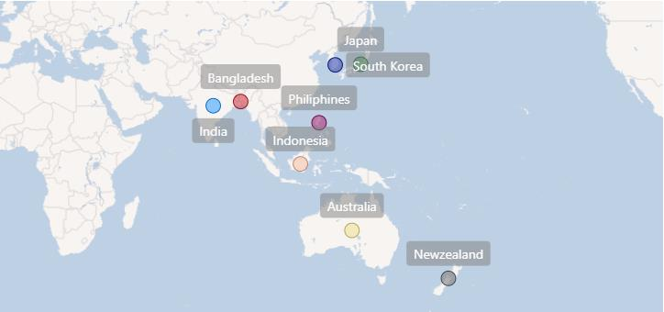
Insights
Atliq Exclusive" maintains a strong presence in numerous countries throughout the APAC region, spanning India, Indonesia, Japan, the Philippines, South Korea, Australia, New Zealand, and Bangladesh. This underscores its resilient market position and its ability to adjust effectively to diverse cultural and economic landscapes within the Asia-Pacific region.

Slide 10
Ad -hoc requests
What is the percentage of unique product increase in 2021vs. 2020?
The final output contains these fields:
unique_products_2020
unique_products_2021
percentage_chg
Output

Slide 11
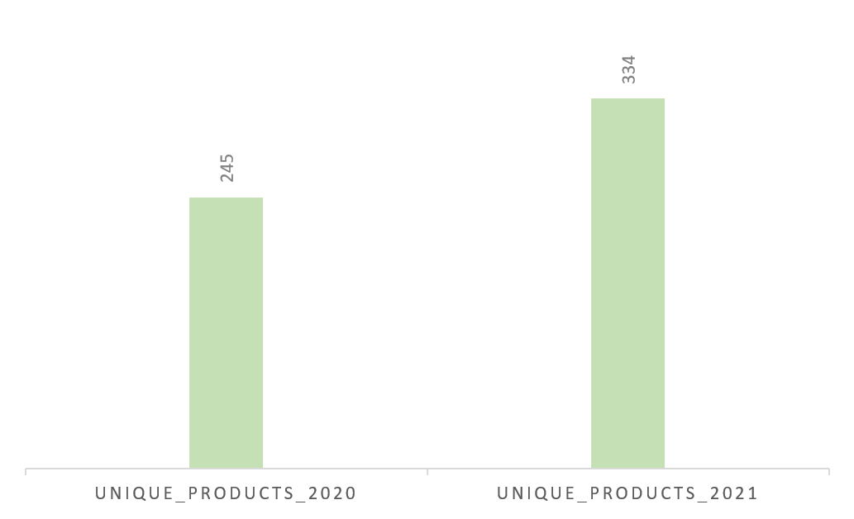
Insights
It's a positive indication of our commitment to innovation and product development that we consistently bring new offerings to the market. In the fiscal year 2020, our product lineup comprised 245 items. However, in fiscal year 2021, we experienced a notable surge, witnessing a 36% increase, resulting in a total of 334 products.

Slide 12
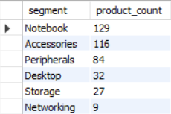
Ad -hoc requests
Provide a report with all the unique product counts for each segment and sort them in descending order of product counts. The final output contains 2 fields:
Segment
product_count
Output

Slide 13
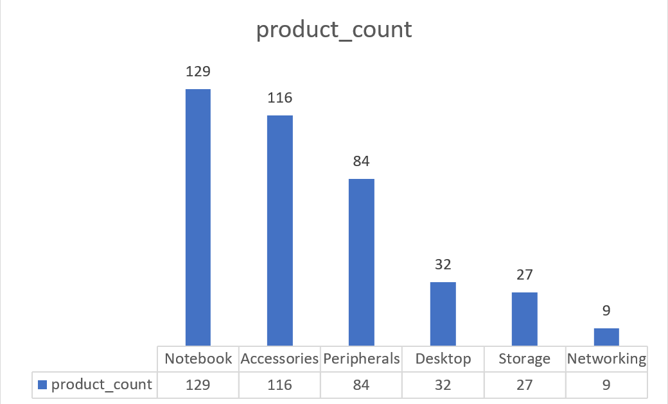
Insights
Among the segments, the "Notebook" category boasts the largest product count, totaling 129 items.
Conversely, the "Networking" segment has the smallest product count, comprising only 9 products.
These findings underscore the diverse product offerings within each segment, showcasing the extensive options available in "Notebook" and "Accessories," while highlighting the more restricted selection in "Networking."
The range of products across segments caters to a multitude of customer preferences and needs, ensuring a versatile and comprehensive market approach.

Slide 14
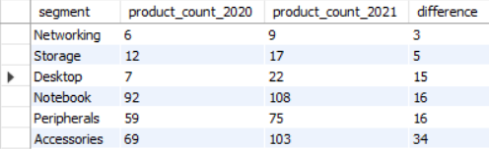
Ad -hoc requests
Which segment had the most increase in unique products in 2021 vs 2020? The final output contains these fields:
Segment
product_count_2020
product_count_2021
difference
Output

Slide 15
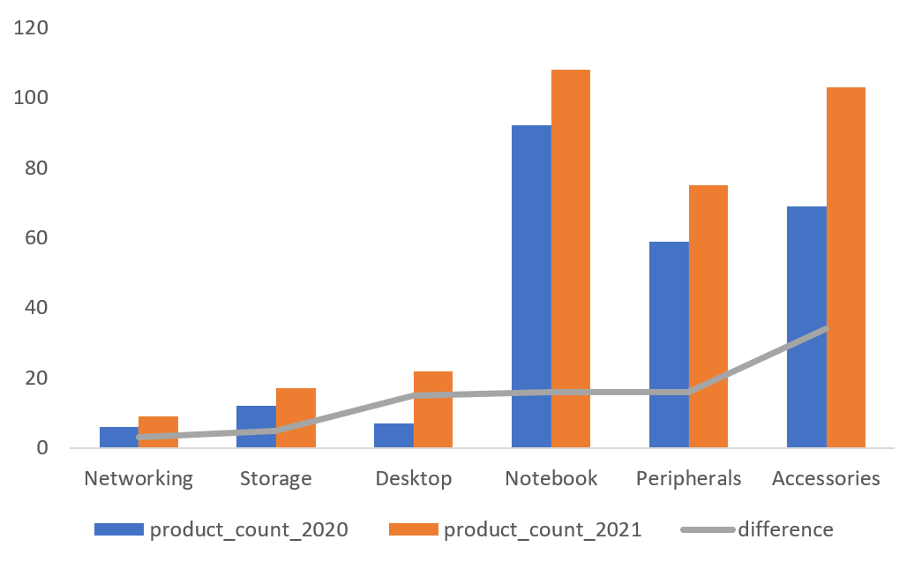
Insights
During 2021, our primary emphasis was on expanding the diversity of our accessories category, with the introduction of 34 new products to the market.

Slide 16

Ad -hoc requests
Get the products that have the highest and lowest manufacturing costs. The final output should contain these fields:
product_code
product
manufacturing_cost
Output

Slide 17


Insights
Which of our products has the highest manufacturing cost?
240.54$
AQ HOME Allin1 Gen 2 (Plus 3)
Personal Desktop
Which of our products has the lowest manufacturing cost?
0.89$
AQ Master wired x1 Ms (Standard 1)
Mouse

Slide 18
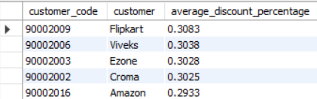
Ad -hoc requests
Generate a report which contains the top 5 customers who received an average high pre_invoice discount_pct for the fiscal year 2021 and in the Indian market. The final output contains these fields:
customer_code
Customer
average_discount_percentage
Output

Slide 19
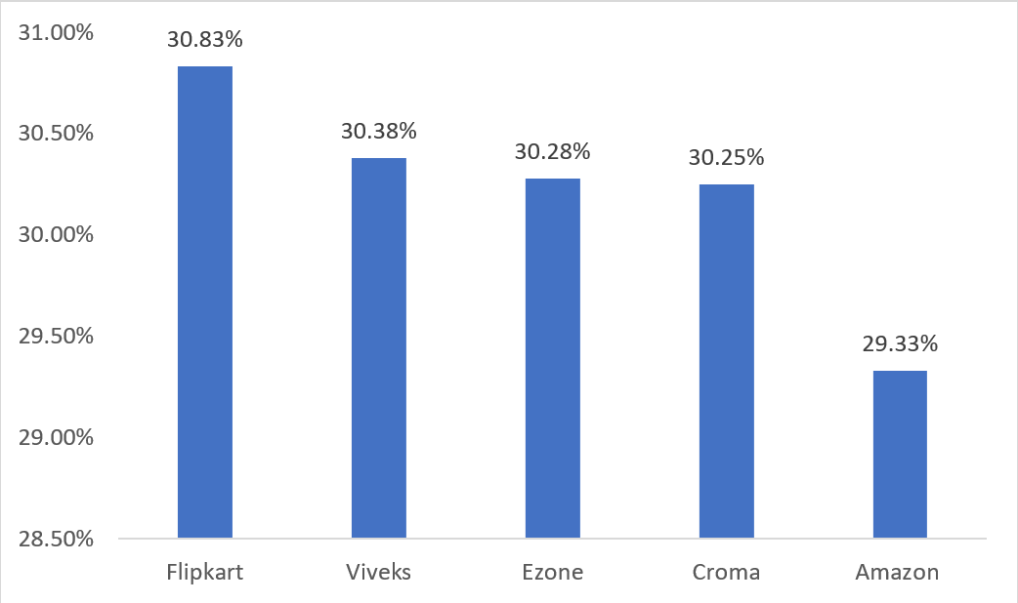
Insights
In the year 2021, we provided nearly identical pre-invoice discount rates to our top five customers. Notably, Flipkart received the highest discount among them, standing at 30.83%, highlighting its position as the most discounted customer in the Indian market.
These findings offer valuable insights for refining discount strategies and gaining a deeper understanding of customer preferences.

Slide 20
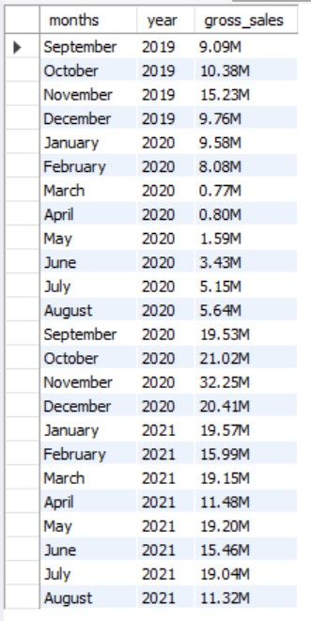
Ad -hoc requests
Get the complete report of the Gross sales amount for the customer “Atliq Exclusive” for each month. This analysis helps to get an idea of low and high performing months and take strategic decisions. The final report contains these columns:
Month
Year
Gross sales Amount

Slide 21
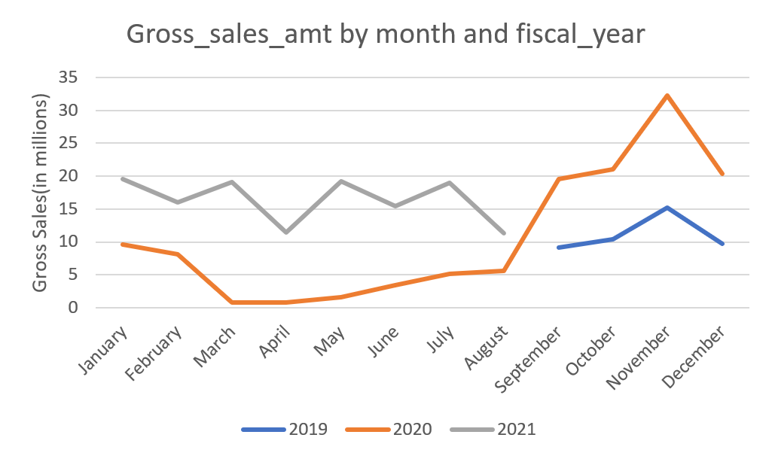
Insights
Atliq Exclusive experienced its peak sales in November 2020, while March 2020 recorded the lowest gross sales. The impact of COVID-19 is apparent in the reduced sales observed between March and August. Nevertheless, a positive trend emerged as sales rapidly rebounded post-August, reaching the highest levels in November—marking the highest point in the past two years.

Slide 22
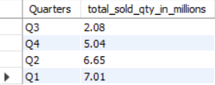
Ad -hoc requests
In which quarter of 2020, got the maximum total_sold_quantity? The final output contains these fields sorted by the total_sold_quantity:
Quarter
total_sold_quantity
Output

Slide 23
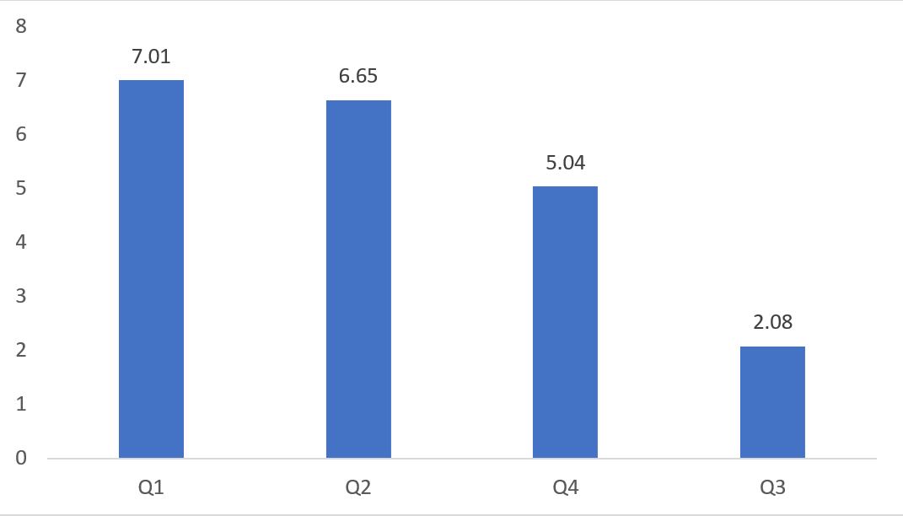
Insights
This further reinforces the earlier observation regarding the impact of COVID-19 on our sales. Specifically, in the third quarter of fiscal year 2020 (encompassing March, April, and May, the peak months of the pandemic), the quantity sold decreased to 2.1 million. However, our recovery commenced swiftly, persisting through the fourth quarter. This early rebound can likely be attributed to the heightened demand for hardware, particularly desktops and notebooks, as a significant number of students initiated or continued their coursework online. Additionally, there was a substantial surge in demand for computer accessories during this period.

Slide 24

Ad -hoc requests
Which channel helped to bring more gross sales in the fiscal year 2021 and the percentage of contribution? The final output contains these fields:
Channel
gross_sales_mln
percentage
Output

Slide 25
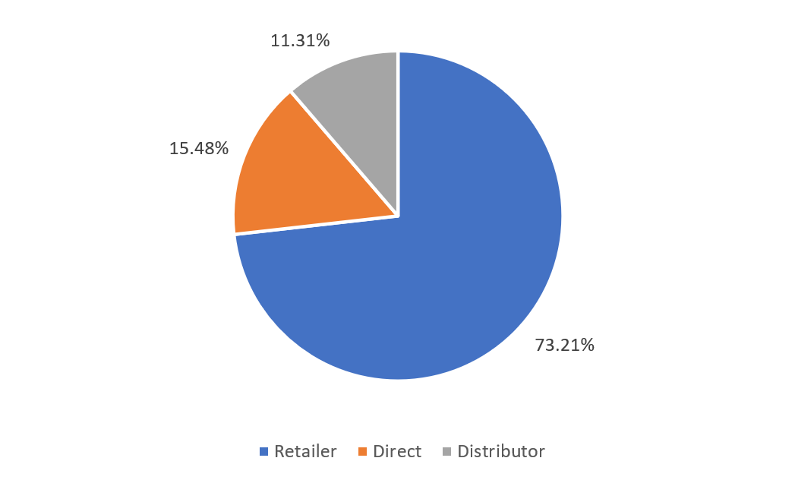
Insights
The majority of sales, amounting to 73.22% of gross sales, are attributed to the "Retailer" channel. The "Direct" channel also holds a noteworthy position, comprising 15.47% of gross sales. The "Distributor" channel contributes 11.31% to gross sales. The notable emphasis on the "Retailer" channel indicates its role as the primary revenue driver. To maximize sales further, there is potential for exploring diversification and growth opportunities in the "Direct" and "Distributor" channels.

Slide 26
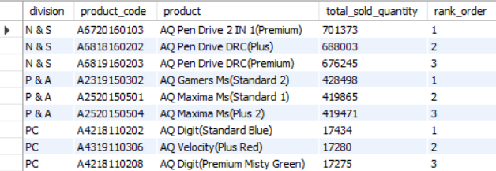
Ad -hoc requests
Get the Top 3 products in each division that have a high total_sold_quantity in the fiscal_year 2021? The final output contains these fields:
Division
product_code
Product
total_sold_quantity
rank_order
Output

Slide 27
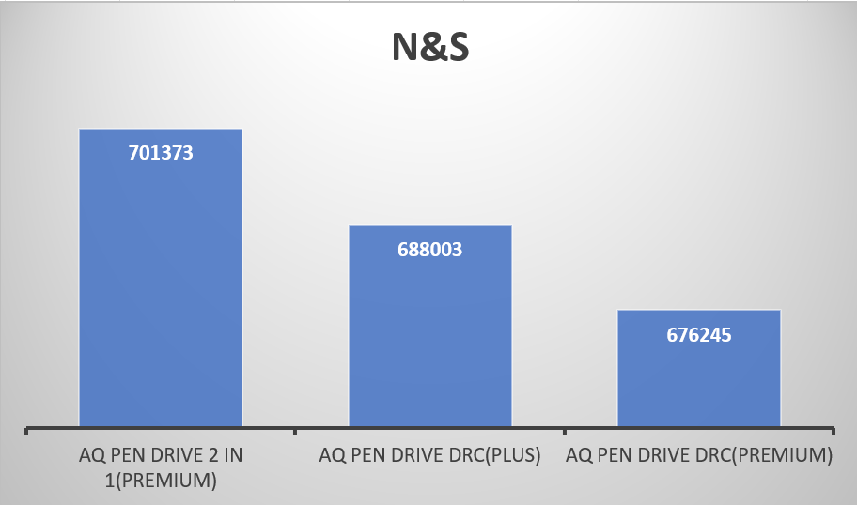
Insights
The three best-selling items in N&S comprised pen drives, with a total quantity of approximately 700,000 units.

Slide 28
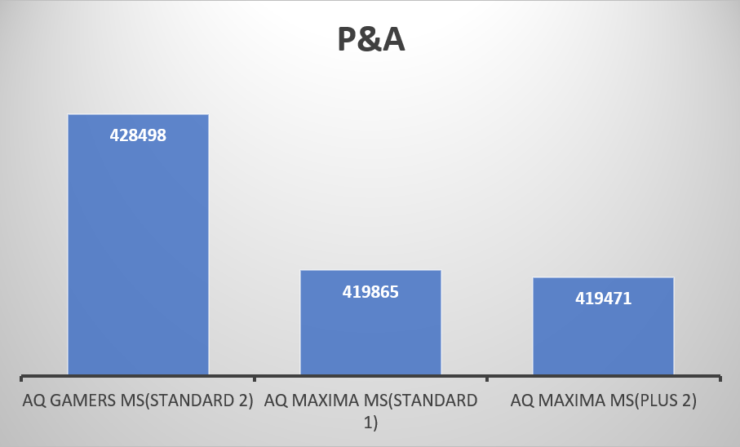
The three highest-selling items in the P&A category were mice, with a total quantity of approximately 400,000 units.

Slide 29
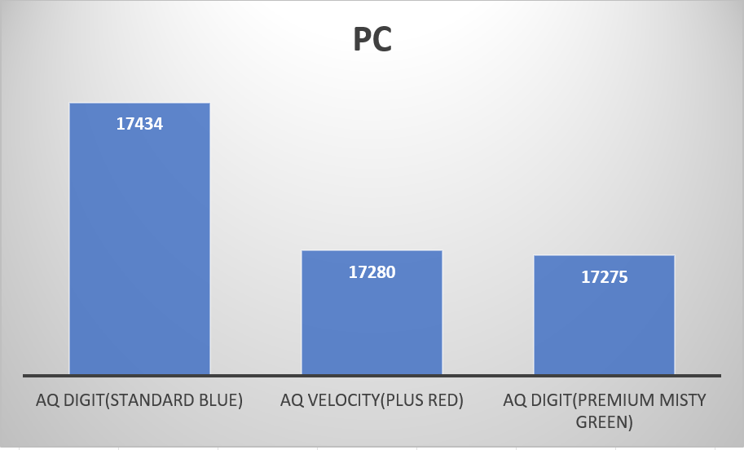
The three highest-selling items within the PC category were personal laptops, with a total quantity of approximately 17,000 units.

Slide 30

END THANK YOU!

